Slide 1
Enhancing Customer Experience: The Role of Gen AI Chatbots in Customer Care

Slide 2

Introduction to Gen AI Chatbots
In today's digital landscape, customer experience is paramount. Gen AI chatbots are revolutionizing customer care by providing instant support and personalized interactions.
This presentation explores the transformative role of these chatbots in enhancing customer satisfaction and engagement.

Slide 3
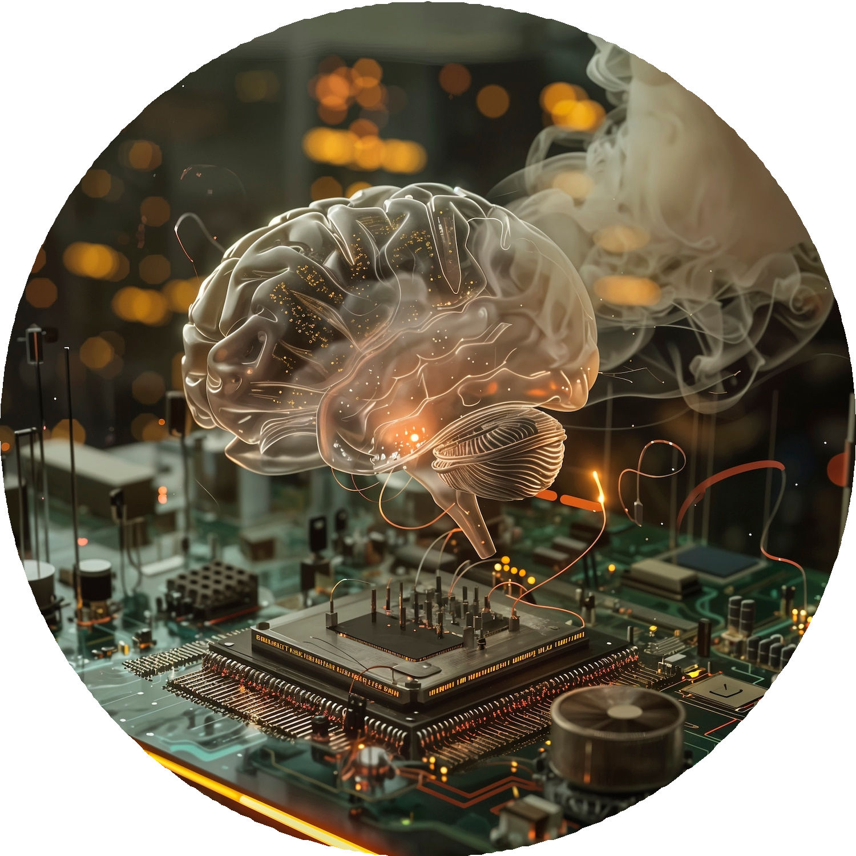
Understanding Gen AI Technology
Gen AI technology utilizes advanced natural language processing and machine learning to understand and respond to customer inquiries. This enables chatbots to deliver accurate responses, making customer interactions seamless and eﬃcient.

Slide 4
Beneﬁts of Chatbots in Customer Care
Implementing chatbots oﬀers several beneﬁts: 24/7 availability, reduced wait times, and consistent responses. They help businesses improve operational eﬃciency while enhancing the overall customer experience.

Slide 5
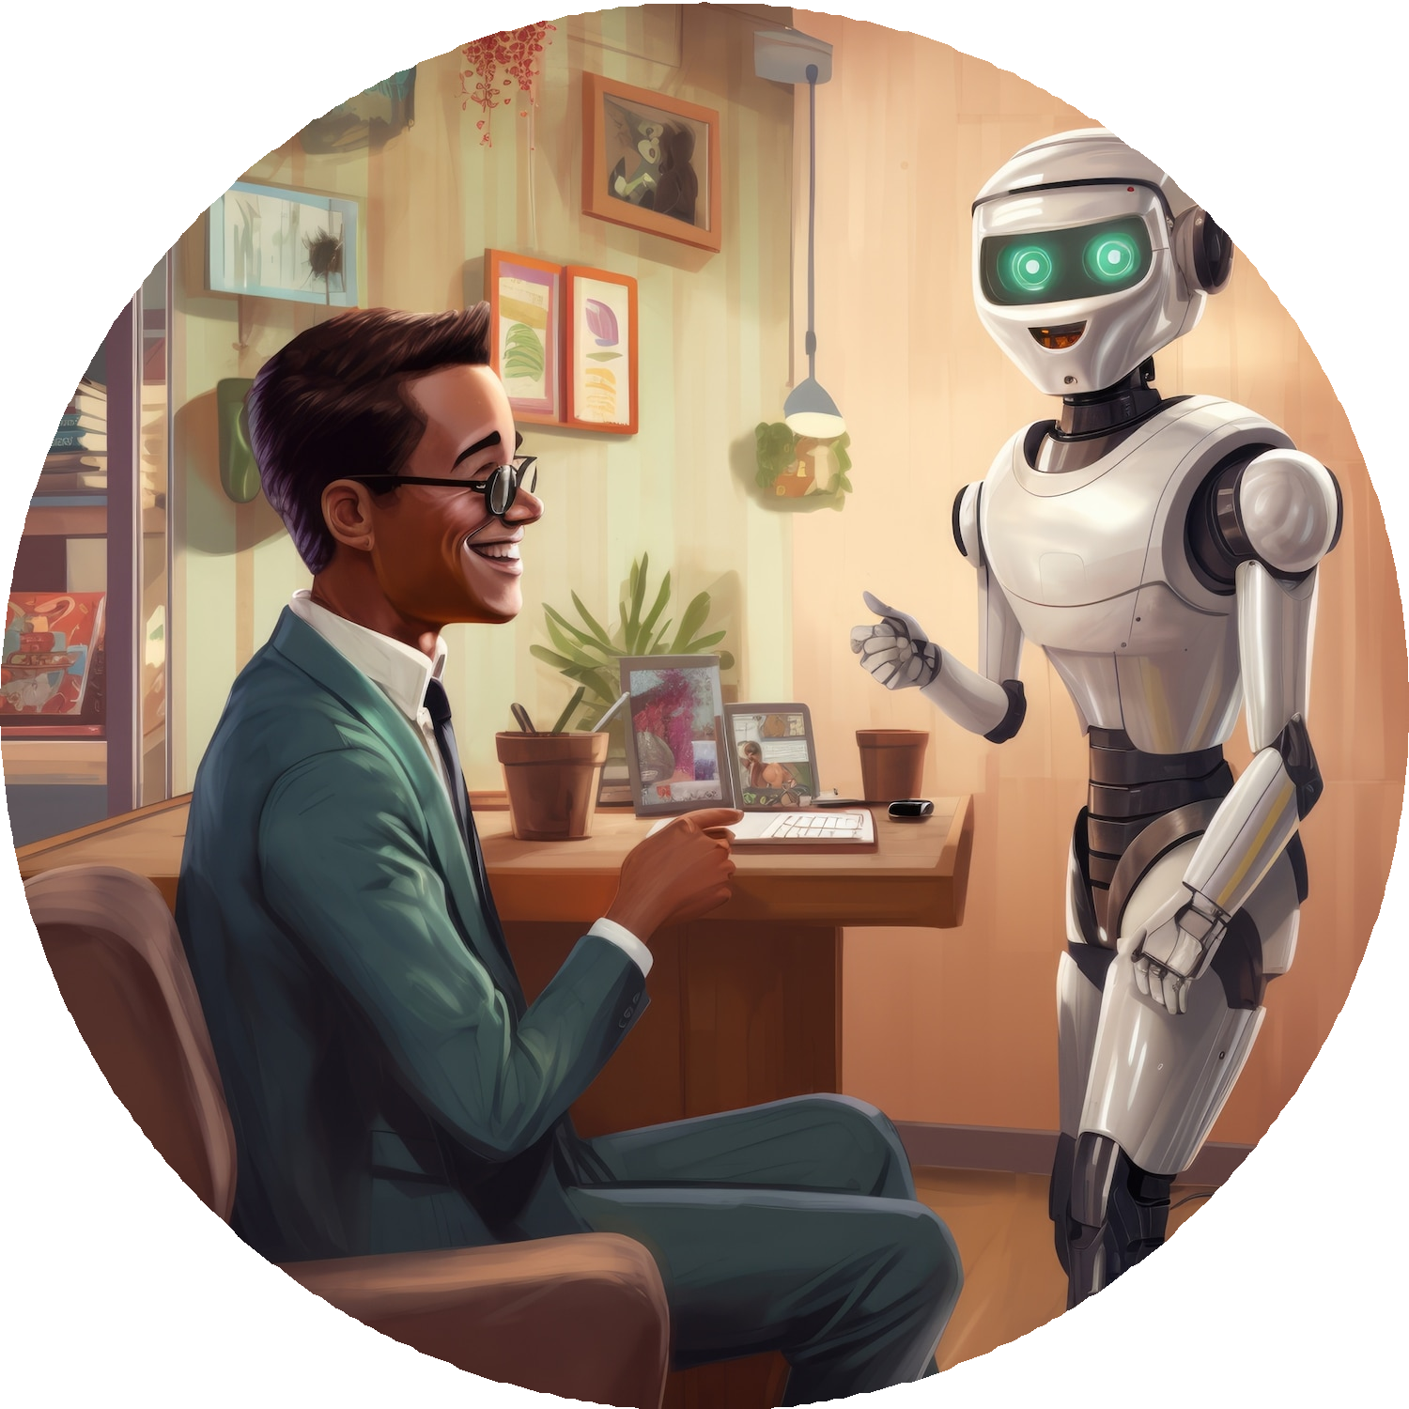
Personalization Through AI
Gen AI chatbots can analyze customer data to provide personalized recommendations and solutions. This tailored approach fosters stronger customer relationships and increases loyalty, as clients feel understood and valued.

Slide 6

Challenges and Considerations
While Gen AI chatbots oﬀer numerous advantages, there are challenges to consider, such as ensuring data privacy and handling complex queries. Businesses must balance automation with the need for human touch in customer interactions.

Slide 7
Conclusion: Future of Customer Care
The integration of Gen AI chatbots in customer care is a game-changer. By enhancing
eﬃciency and personalization, they are set to redeﬁne customer interactions.
Embracing this technology is crucial for businesses aiming to thrive in a competitive landscape.

Slide 8
Thanks!
Done by
-Akkash
-Bharani
-Darshan
-Muhammad Younus

